Slide 1

Garbage Detection in Images Using CNN
This presentation explores the power of deep learning for image processing, specifically focusing on detecting garbage in images using Convolutional Neural Networks (CNNs).
Presented by: (Group No. 24)
Ankit Srivastava
Chandaka Giri Babu
Aditya Tripathi
Mentored by:
Dr. Koushlendra Kumar Singh

Slide 2

Overview of Garbage Detection with CNN
1
What is Garbage Detection?
Automatically identifying waste in images for smart city initiatives.
2
Why is This Important?
Environmental benefits: efficient waste collection, cleaner cities. Scalable for large-scale waste monitoring.
3
Why CNN?
Excels at image classification, handles complex image data effectively.

Slide 3

Preparing Image Data
Image Resizing
Normalization
Data Augmentation
Resized to 128x128 pixels for uniformity.
Pixel values scaled between 0 and 1.
Rotation, zooming, flipping for diversity.

Slide 4




Convolutional Neural Network Structure
Convolutional Layers
Extract image features.
Pooling Layers
Downsample and reduce dimensionality.
Dense Layers
Classify based on extracted features.

Slide 5

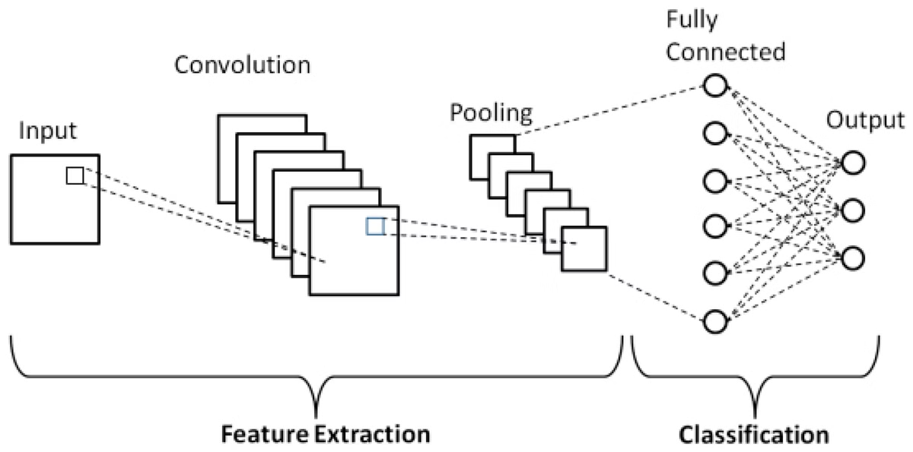
Detailed CNN Architecture
1
Layer 1
32 filters, 3x3 kernel, max pooling.
2
Layer 2
64 filters, 3x3 kernel, max pooling.
3
Layer 3
128 filters, 3x3 kernel, max pooling.

Slide 6
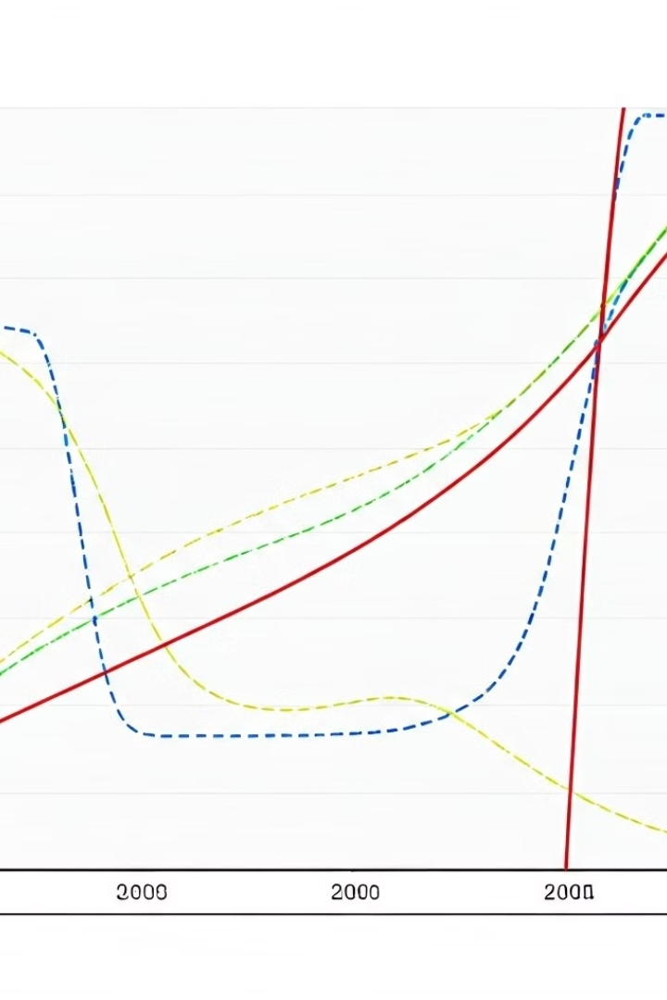
Training the CNN Model
1
Epochs and Optimizer
10 epochs using Adam optimizer.
2
Loss Function
Binary Cross-Entropy.
3
Validation
20% of data reserved for testing.

Slide 7
Evaluating CNN Performance
Confusion Matrix
Metrics
Visualization
Visualizes true/false positives/negatives.
Accuracy and loss measured.
Accuracy/loss curves plotted.

Slide 8

Model Optimization
1
Grid Search
2
Tuned Parameters
Used for hyperparameter tuning.
Learning rate, filters, dropout rate.

Slide 9


Future Enhancement - Website Integration
Objective
User-friendly website for image uploads.
Process
Deploy using Flask/Django, host on cloud.
User Interaction
Upload images, get garbage classification results.

Slide 10

Conclusion
1
Success
High accuracy in garbage detection.
2
Future
Website deployment for public use.
3
Next Steps
Finalize deployment, improve accuracy.

